Slide 1
UML State Machines
Used to model the dynamic behaviour of a process
Can be used to model a high level behaviour of an entire system
Can be used to model the detailed behaviour of a single object
All other possible levels of detail in between these extremes is also possible

Slide 2
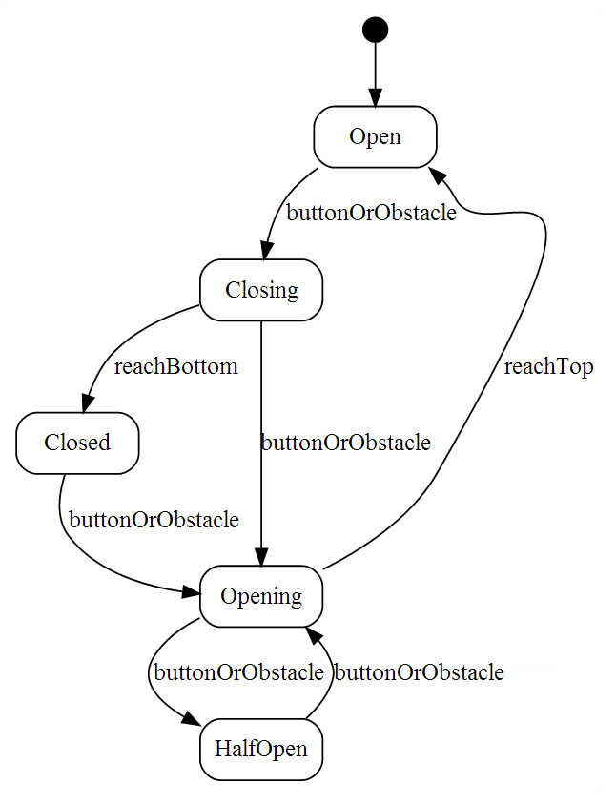
UML State Machine Example
Example of a garage door state machine
(We will come back to this example later)

Slide 3
States
Symbol for a state
A system in a state will remain in it until the occurrence of an event that will cause it to transition to another one
Being in a state means that a system will behave in a predetermined way in response to a given event
Symbols for the initial and final states

Slide 4
States
Numerous types of events can cause the system to transition from one state to another
In every state, the system behaves in a different matter
Names for states are usually chosen as:
Adjectives: open, closed, ready…
Present continuous verbs: opening, closing, waiting…

Slide 5
Transitions
Transitions are represented with arrows

Slide 6
Transitions
Transitions represent a change in a state in response to an event
Theoretically, it is supposed to occur in a instantaneous manner (it does not take time to execute)
A transition can have”
Trigger: causes the transition; can be an event of simply the passage of time
Guard: a condition that must evaluate to true for the transition to occur
Effect: an action that will be invoked directly on the system of the object being modeled (if we are modeling an object, the effect would correspond to a specific method)

Slide 7
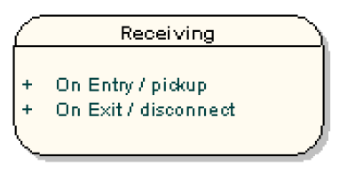
State Actions
An effect can also be associated with a state
If a destination state is associated with numerous incident transitions (transitions arriving a that state), and every transition defines the same effect:
The effect can therefore be associated with the state instead of the transitions (avoid duplications)
This can be achieved using an “On Entry” effect (we can have multiple entry effects)
We can also add one or more “On Exit” effect

Slide 8
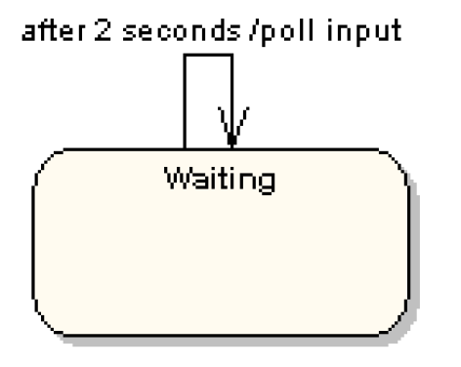
Self Transition
State can also have self transitions
These self transition are more useful when they have an effect associated with them
Timer events are usually popular with self transitions
Below is a typical example:

Slide 9
Coming back to Our Initial Example
Example of a garage door state machine

Slide 10
Decisions
Just like activity diagrams, we can use decisions nodes (although we usually call them decision pseudo-states)
Decision pseudo-states are represented with a diamond
We always have one input transition and multiple outputs
The branch of execution is decided by the guards associated with the transitions coming out of the decision pseudo-state

Slide 11
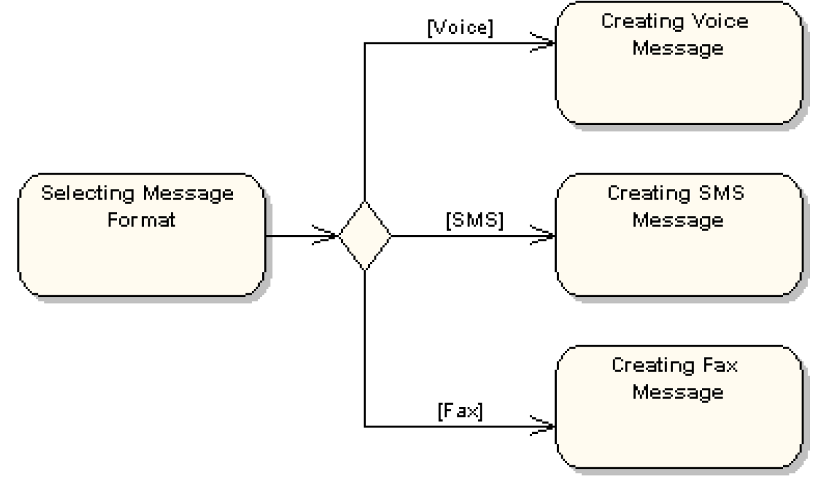
Decisions

Slide 12
Compound States
A state machine can include several sub-machines
Below is an example of a sub-machine included in the compound state “Connected”
Connected
Waiting
disconnect
Disconnected
receiveByte
byteProcessed
ProcessingByte
connect
closeSession

Slide 13
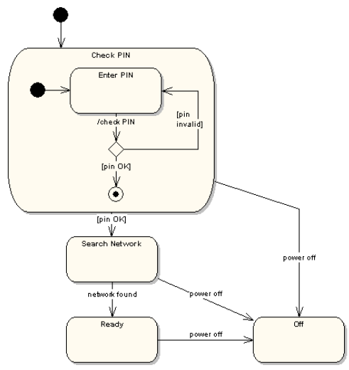
Compound States Example

Slide 14
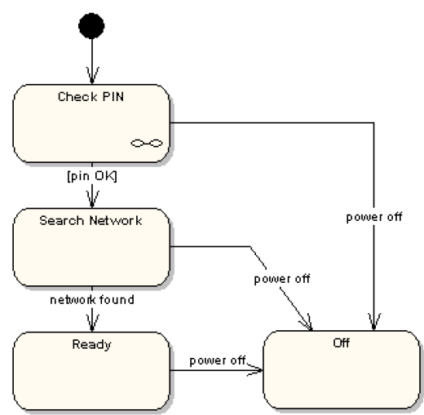
Compound States Example
Same example, with an alternative notation
The link symbol in the “Check Pin” state indicates that the details of the sub-machine associated with “Check Pin” are specified in an another state machine

Slide 15
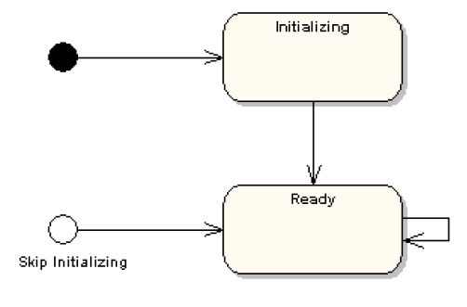
Alternative Entry Points
Sometimes, in a sub-machine, we do not want to start the execution from the initial state
We want to start the execution from a “name alternative entry point”
PerformActivity

Slide 16
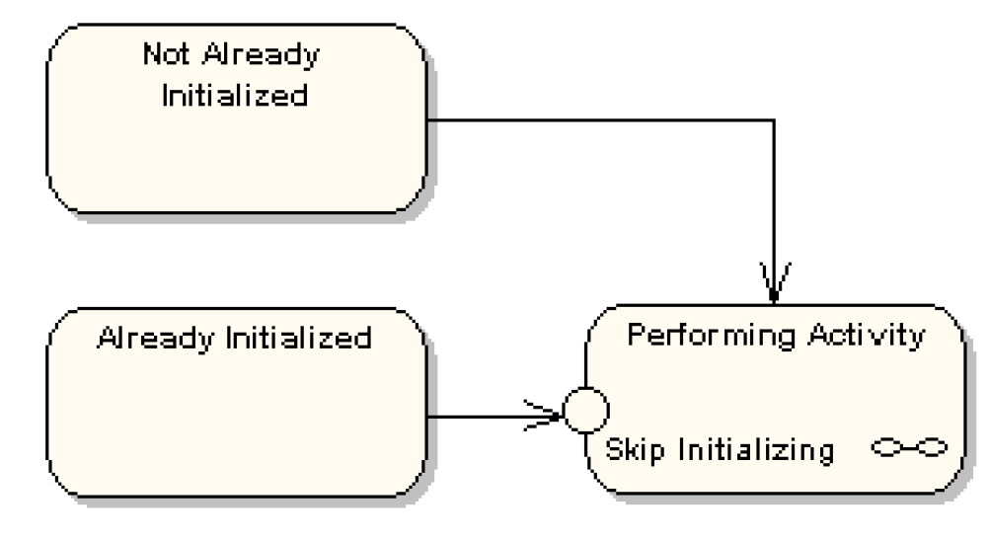
Alternative Entry Points
Here’s the same system, from a higher level
Transition from the “No Already Initialized” state leads to the standard initial state in the sub-machine
Transition from the “Already Initialized” state is connected to the named alternative entry point “Skip Initializing”

Slide 17
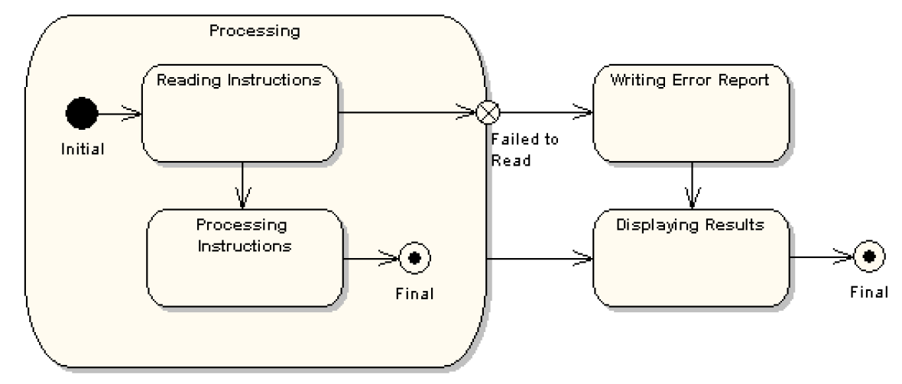
Alternative Exit Points
It is also possible to have alternative exit points for a compound state
Transition from “Processing Instructions” state takes the regular exit
Transition from the “Reading Instructions” state takes an "alternative named exit point

Slide 18
Use Case – Validate PIN (1)
Use case name: Validate PIN
Summary: System validates customer PIN
Actor: ATM Customer
Precondition: ATM is idle, displaying a Welcome message.

Slide 19
Use Case – Validate PIN (2)
Main sequence:
Customer inserts the ATM card into the card reader.
If system recognizes the card, it reads the card number.
System prompts customer for PIN.
Customer enters PIN.
System checks the card's expiration date and whether the card has been reported as lost or stolen.
If card is valid, system then checks whether the user-entered PIN matches the card PIN maintained by the system.
If PIN numbers match, system checks what accounts are accessible with the ATM card.
System displays customer accounts and prompts customer for transaction type: withdrawal, query, or transfer.

Slide 20
Use Case – Validate PIN (3)
Alternative sequences:
Step 2: If the system does not recognize the card, the system ejects the card.
Step 5: If the system determines that the card date has expired, the system confiscates the card.
Step 5: If the system determines that the card has been reported lost or stolen, the system confiscates the card.
Step 7: If the customer-entered PIN does not match the PIN number for this card, the system re-prompts for the PIN.
Step 7: If the customer enters the incorrect PIN three times, the system confiscates the card.
Steps 4-8: If the customer enters Cancel, the system cancels the transaction and ejects the card.
Postcondition: Customer PIN has been validated.

Slide 21
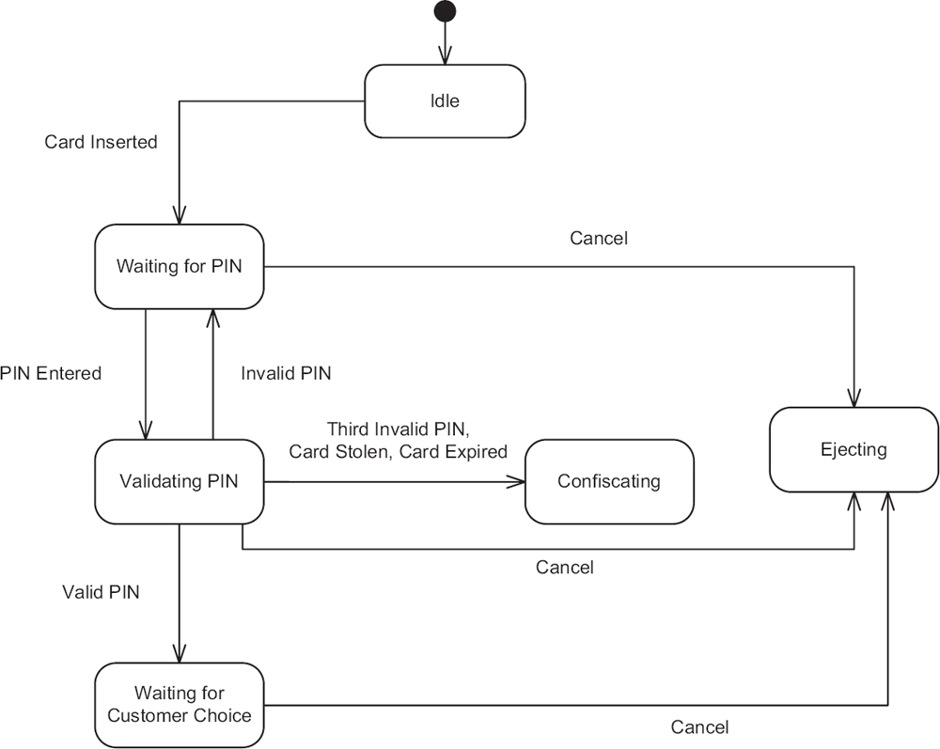
ATM Machine Example
Validate PIN:

Slide 22
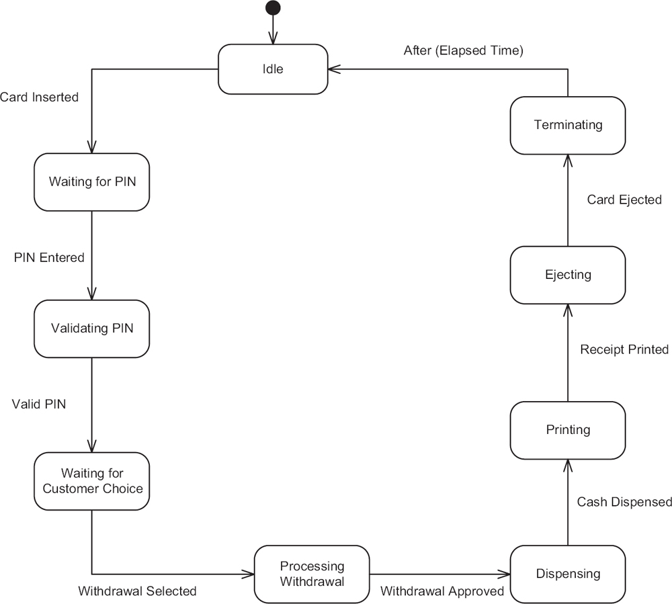
ATM Machine Example
Funds withdrawal:

Slide 23
Section 4
Behavioral Modeling

Slide 24
Topics
We will continue to talk about UML State Machine
We will go through a complete example of a simple software construction case study with emphasis on UML State Machines
End this section with some final words of wisdom!

Slide 25
Last Lecture
We have talked about UML State Machines
States and transitions
State effects
Self Transition
Decision pseudo-states
Compound states
Alternative entry and exit points
Today, we will tackle more advanced UML State Machines Concepts

Slide 26
History States
A state machine describes the dynamic aspects of a process whose current behavior depends on its past
A state machine in effect specifies the legal ordering of states a process may go through during its lifetime
When a transition enters a compound state, the action of the nested state machine starts over again at its initial state
Unless an alternative entry point is specified
There are times you'd like to model a process so that it remembers the last substate that was active prior to leaving the compound state

Slide 27
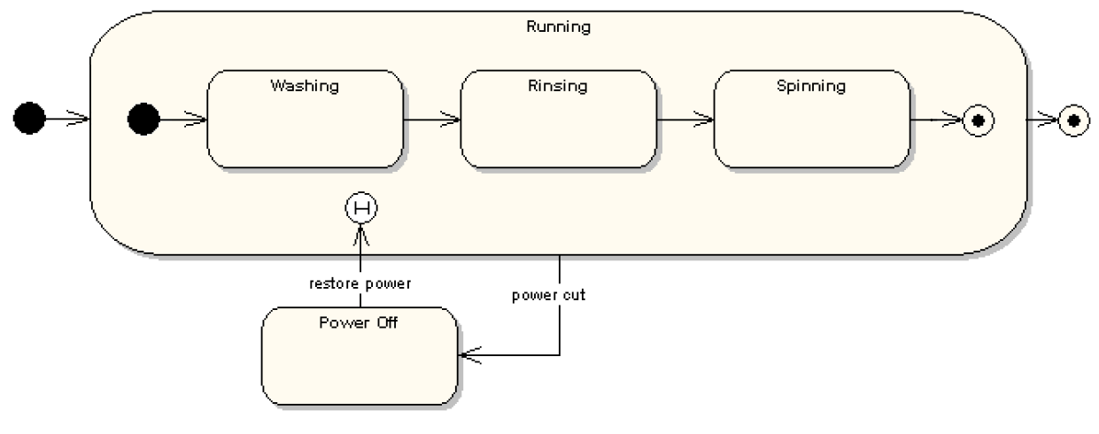
History States
Simple washing machine state diagram:
Power Cut event: transition to the “Power Off” state
Restore Power event: transition to the active state before the power was cut off to proceed in the cycle

Slide 28
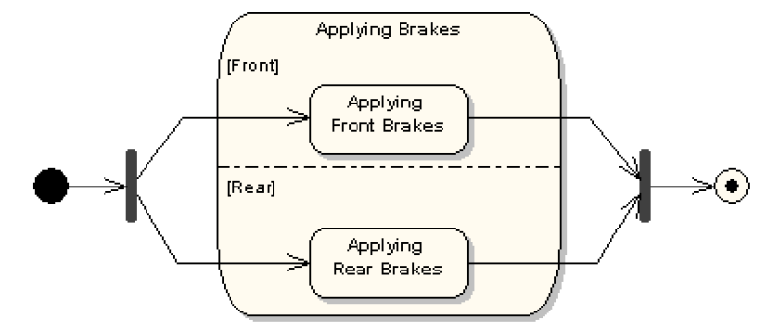
Concurrent Regions
Sequential sub state machines are the most common kind of sub machines
In certain modeling situations, concurrent sub machines might be needed (two or more sub state machines executing in parallel)
Brakes example:

Slide 29
Concurrent Regions
Example of modeling system maintenance using concurrent regions
Maintenance
Testing
testingCompleted
shutDown
Testing devices
Self diagnosing
diagnosisCompleted
Idle
maintain
Commanding
commandProcessed
[continue]
Waiting
Processing Command
commandProcessed
[not continue]
command

Slide 30
Orthogonal Regions
Concurrent Regions are also called Orthogonal Regions
These regions allow us to model a relationship of “And” between states (as opposed to the default “or” relationship)
This means that in a sub state machine, the system can be in several states simultaneously
Let us analyse this phenomenon using an example of computer keyboard state machine

Slide 31
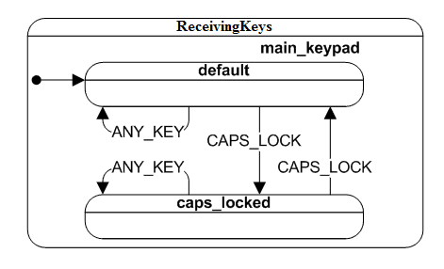
Keyboard Example (1)
Keyboard example without Orthogonal Regions

Slide 32
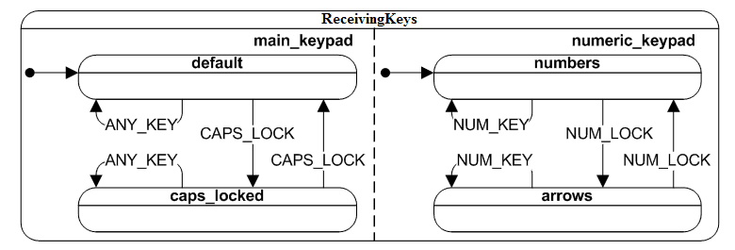
Keyboard Example (2)
Keyboard example with Orthogonal Regions

Slide 33
Garage Door – Case Study
Background
Company DOORS inc. manufactures garage door components
Nonetheless, they have been struggling with the embedded software running on their automated garage opener Motor Unit that they developed in house
This is causing them to loose business
They decided to scrap the existing software and hire a professional software company to deliver “bug free” software

Slide 34
Client Requirements
Client (informal) requirements:
Requirement 1: When the garage door is closed, it must open whenever the user presses on the button of the wall mounted door control or the remote control
Requirement 2: When the garage door is open, it must close whenever the user presses on the button of the wall mounted door control or the remote control
Requirement 3: The garage door should not close on an obstacle
Requirement 4: There should be a way to leave the garage door half open
Requirement 5: System should run a self diagnosis test before performing any command (open or close) to make sure all components are functional

Slide 35
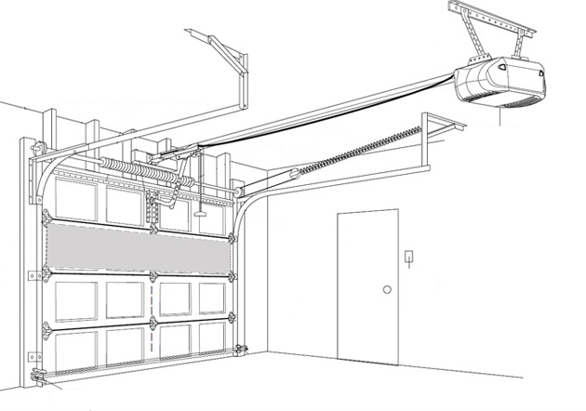
Client Requirements
Motor Unit
(includes a microcontroller where the software will be running)
Wall Mounted Controller
(a remote controller is also supported)
Sensor Unit(s)
(detects obstacles, when the door is fully open and when it is fully closed)

Slide 36
Use Case Diagram
Use Case Diagram
Garage Door System
Open Door
include
Run Diagnosis
Close Door
Garage Door User
include

Slide 37
Run Diagnosis Use Case
Use Case Name: Run Diagnosis
Summary: The system runs a self diagnosis procedure
Actor: Garage door user
Pre-Condition: User has pressed the remote or wall mounted control button
Sequence:
Check if the sensor is operating correctly
Check if the motor unit is operating correctly
If all checks are successful, system authorizes the command to be executed
Alternative Sequence:
Step 3: One of the checks fails and therefore the system does not authorize the execution of the command
Postcondition: Self diagnosis ensured that the system is operational

Slide 38
Open Door Use Case
Use Case Name: Open Door
Summary: Open the garage the door
Actor: Garage door user
Dependency: Include Run Diagnosis use case
Pre-Condition: Garage door system is operational and ready to take a command
Sequence:
User presses the remote or wall mounted control button
Include Run Diagnosis use case
If the door is currently closing or is already closed, system opens the door
Alternative Sequence:
Step 3: If the door is open, system closes door
Step 3: If the door is currently opening, system stops the door (leaving it half open)
Postcondition: Garage door is open

Slide 39
Close Door Use Case
Use Case Name: Close Door
Summary: Close the garage the door
Actor: Garage door user
Dependency: Include Run Diagnosis use case
Pre-Condition: Garage door system is operational and ready to take a command
Sequence:
User presses the remote or wall mounted control button
Include Run Diagnosis use case
If the door is currently open, system closes the door
Alternative Sequence:
Step 3: If the door is currently closing or is already closed, system opens the door
Step 3: If the door is currently opening, system stops the door (leaving it half open)
Postcondition: Garage door is closed

Slide 40
High Level Behavioral Modeling

Slide 41
High Level Structural Model

Slide 42
Refined Structural Model

Slide 43
Refine Behavioral Model – Motor Unit
Running
Open
buttonPressed() [isFunctioning()]
Timer (180 s)
[! isFunctioning()]
Closing
doorOpen()
doorClosed()
buttonPressed(),
obstacleDetected()
[isFunctioning()]
buttonPressed(),
[! isFunctioning()]
WaitingForRepair
Closed
Timer (180 s)
[isFunctioning()]
buttonPressed() [isFunctioning()]
Opening
buttonPressed()
buttonPressed()
HalfOpen

Slide 44
Refine Behavioral Model – Sensor Unit
CheckingForObstacles
SendingObstacleEvent
[isObstacleDetected()]
[!isObstacleDetected()]
CheckingIfDoorOpen
Time (20 ms)
SendingOpenDoorEvent
[isDoorOpen()]
[!isDoorOpen()]
CheckingIfDoorClosed
SendingDoorClosedEvent
[isDoorClosed()]
[!isDoorClosed()]
Sleeping

Slide 45
Do Not Fall Asleep yet!

Slide 46
Coding
Whenever we are satisfied with the level of detail in our behavioral models, we can proceed to coding
Some of the code can be generated directly by tools from the behavioral model
Some tweaking might be necessary (do not use the code blindly)
Humans are still the smartest programmers

Slide 47
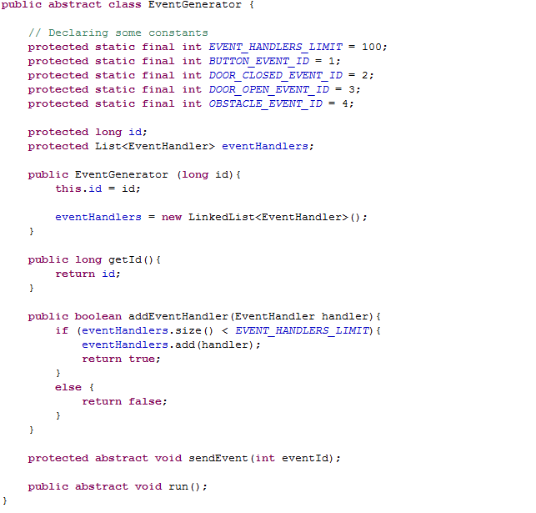
Event Generator Class

Slide 48
Sensor Class

Slide 49
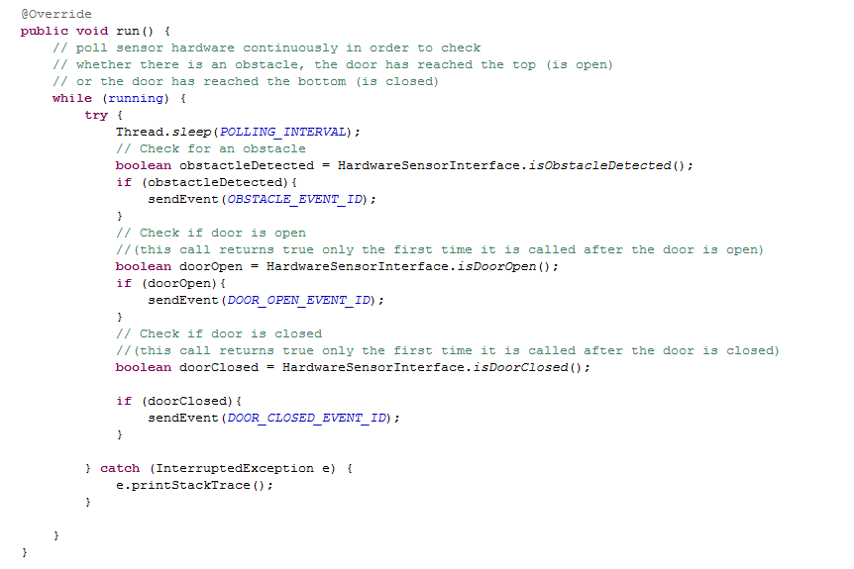
Sensor Class
Sensor
State machine Implementation

Slide 50
Umple Online Demo
UMPLE is a modeling tool to enable what we call Model-Oriented Programming
This is what we do in this course
You can use it to create class diagrams (structural models) and state machines (behavioral models)
The tool was developed at the university of Ottawa
Online version can be found at:
http://cruise.eecs.uottawa.ca/umpleonline/
There’s also an eclipse plugin for the tool

Slide 51
Umple Code For Motor Unit State Machine
class Motor {
status {
Running {
Open {buttonPressed[isFunctioning()]->Closing; }
Closing { buttonPressed()[isFunctioning()]->Opening;
ObstacleDetected()[isFunctioning()]->Opening;
doorClosed()->Closed;}
Closed { buttonPressed()[isFunctioning()]->Opening; }
Opening { buttonPressed()->HalfOpen;
doorOpen()->Open; }
HalfOpen{buttonPressed()->Opening;}
buttonPressed()[!isFunctioning()]->WaitingForRepair;
}
WaitingForRepair{
timer()[!isFunctioning()]->WaitingForRepair;
timer()[isFunctioning()]->Running;}
}
}

Slide 52
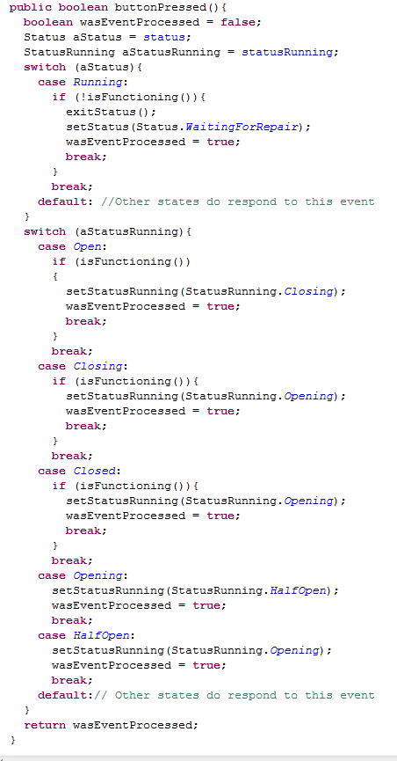
Motor Class Snippets
Switching between high level states
Switching between nest states inside the Running compound state

Slide 53
When To Use State Machines?
When an object or a system progresses through various stages of execution (states)
The behavior of the system differs from one stage to another
When you can identify clear events that change the status of the system
They are ideal for event driven programming (less loops and branches, more events generated and exchanged)
Lots of event are being exchanged between objects
When using even driven programming
Make sure you follow Observable or Event Notifier patterns
Both are pretty simple (similar to what we have done for the garage door example)

Slide 54
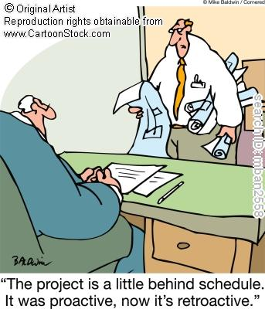
Behavioral Over-Modeling
Please model responsibly!!
Do not get carried out with modeling every single detail to the point where you run behind schedule
You sell code, not models…

Slide 55
Behavioral Over-Modeling
Now, be careful, you do not want over-model
Modern software development processes are all about only doing just enough modeling for a successful product
Therefore, start with a high level model of the behavior
This model should give a clear overview of some (not necessary all) of the important functionality of the system
This would be similar to the first garage door state machine we created

Slide 56
Behavioral Over-Modeling
Identify potential complex areas that require further understanding
We minimize the risk if we understand these components well before we start programing
Model these complex areas in more details until you are satisfied that they are well understood
Use tools to generate code from your existing models
Do not rely blindly on tools (at least not yet!)

Slide 57
Designing Classes with State Diagrams
Keep the state diagram simple
State diagrams can very quickly become extremely complex and confusing
At all time, you should follow the aesthetic rule: “Less is More”
If the state diagram gets too complex consider splitting it into smaller classes
Think about compound states instead of a flat design

Slide 58
Example of a CD Player with a Radio
On
Display Alarm
Displaying Current Time
Displaying Alarm Time
Timer (3 s)
Play CD
Playing Radio
Playing CD
H
Play Radio
On
On
Off
off

Slide 59
More UML State Machines Examples
Flight State Machine

Slide 60
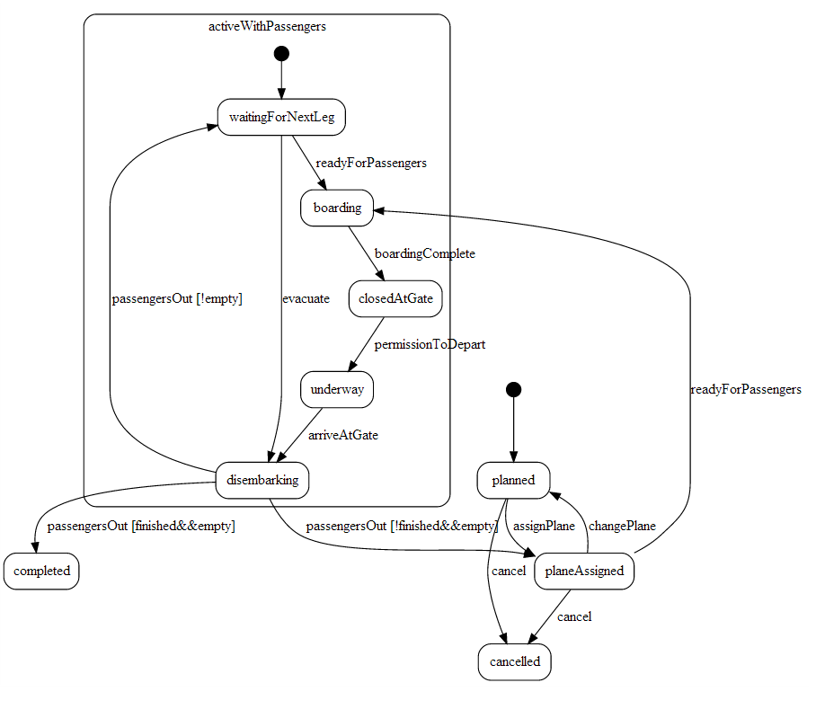
More UML State Machines Examples
Flight State Machine Nested

